Slide 1
Amazon Top 50 Best Sellers Summary
By Beng Ren Siew

Slide 2
Overview
The dataset is a collection of data for the Top 50 Best Sellers of books from 2009-2019 . The overall dataset contains 550 rows of data.
The information that is provided are:
Name (title of the book)
Author
User rating
Reviews (number of reviews)
Year (year that it is in Top 50)
Genre (whether it is fiction or non-fiction)

Slide 3
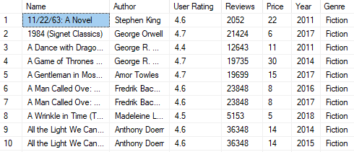

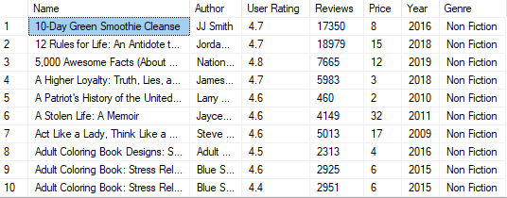

Summaries: Fiction and Non-Fiction
These tables show the first 10 rows of the data categorised into Fiction and Non-Fiction
Total number of books that are fiction
Total number of books that are non-fiction
As shown on the smaller table below, we can see that overall, in the top 50s through the different years, there has been more non-fiction books than there has been fiction books that has placed within the top 50.

Slide 4
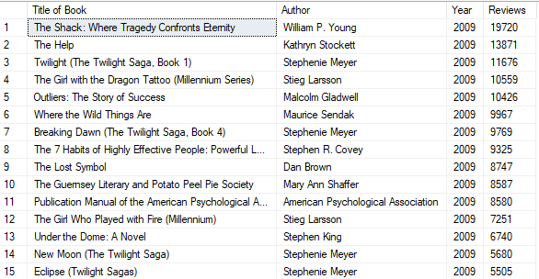
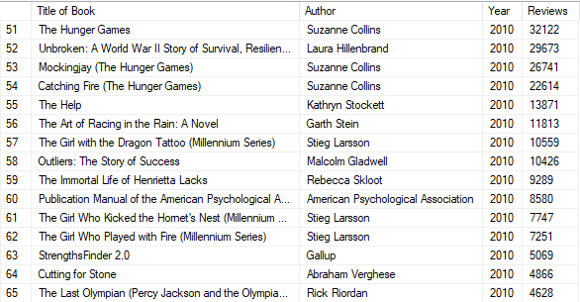
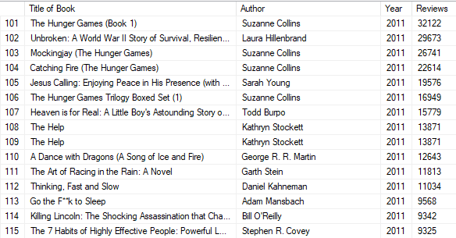
Summaries: Top 50 Best Sellers
Top 50 Best Sellers over 2009 - 2011
These tables show the first 15 rows of the data for the top 50 displaying ‘Title of Book, Author, Year and Reviews’ as columns. The Year is the primary column that is ascending in order and the number of Reviews is the secondary columns that is organised in descending order
From looking at the data we can see that the best sellers from 2009 is completely different based on the number of reviews compared to 2010 and 2011, where we can see some books have stayed as top best sellers. For Example, the Top 4 in 2010 and 2011 are the same. Furthermore, we can see a rise in the number of reviews overall.

Slide 5
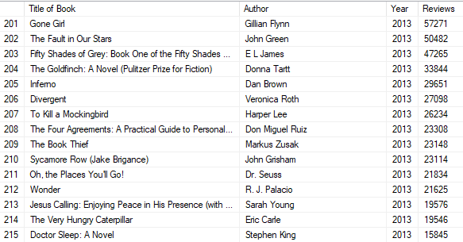
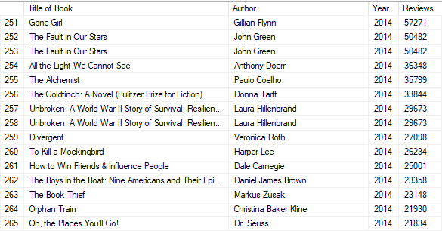
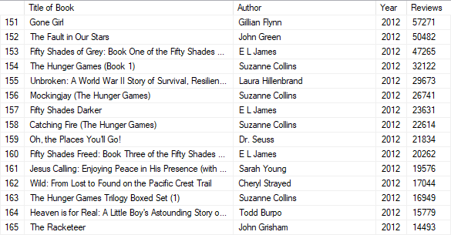
Summaries: Top 50 Best Sellers
Top 50 Best Sellers over 2012 - 2014
These tables show the first 15 rows of the data for the top 50 displaying ‘Title of Book, Author, Year and Reviews’ as columns. The Year is the primary column that is ascending in order and the number of Reviews is the secondary columns that is organised in descending order
From 2012 -2014 we can see another surge in number of reviews and a few new books taking the top spot based on those numbers.

Slide 6
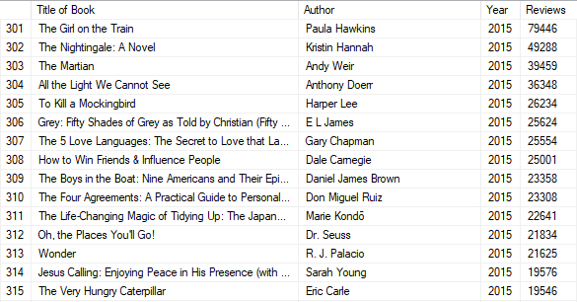
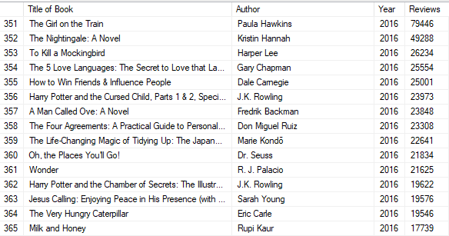
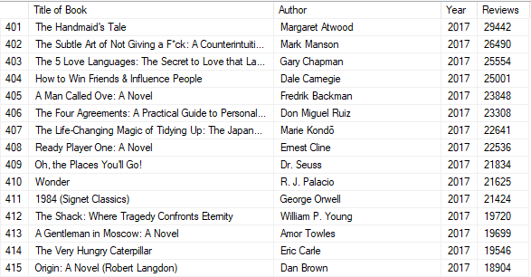
Summaries: Top 50 Best Sellers
Top 50 Best Sellers over 2015 - 2017
These tables show the first 15 rows of the data for the top 50 displaying ‘Title of Book, Author, Year and Reviews’ as columns. The Year is the primary column that is ascending in order and the number of Reviews is the secondary columns that is organised in descending order
Total number of books that are non-fiction
We can continue to see the trend of increased reviews from 2015-2016 but a sharp decline from 2017

Slide 7
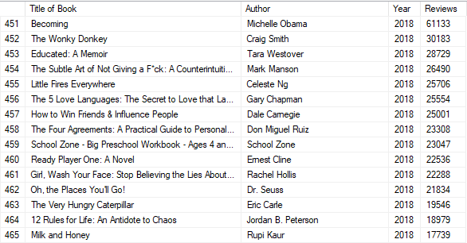
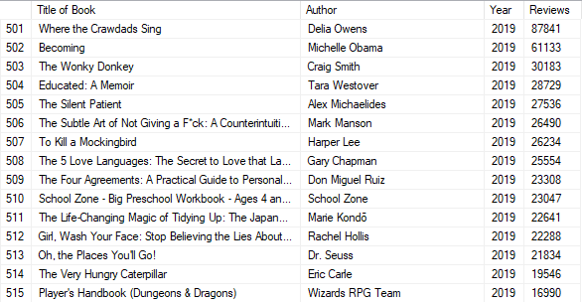
Summaries: Top 50 Best Sellers
Top 50 Best Sellers over 2018 - 2019
These tables show the first 15 rows of the data for the top 50 displaying ‘Title of Book, Author, Year and Reviews’ as columns. The Year is the primary column that is ascending in order and the number of Reviews is the secondary columns that is organised in descending order
From 2018- 2019 we continue the trend of increased number of reviews with 2019 having the highest number of reviews in the dataset for a single book ‘Where the Crawdads Sing’ with 87841 reviews. In 2019

Slide 8
Summaries: Top 50 Best Sellers
From the previous tables that show the data of the Top 50 books each year, We can see a trend of increasing number of reviews. This indicates the relevancy of the title and likely external influence and interest. For example, the Hunger Game series first released in 2008 with a rise with the most reviews in 2010-2011 is likely dues to anticipation to the upcoming release of the movie adaptation in 2012
The changing titles within the top 50 is also likely due to the increase variety of audiences/readers as proven by the trend in reviews.
Furthermore, titles that appear more than once in the top 50 e.g. 2014 number 2 and 3 ‘The Fault in Our Stars’ have different price points suggesting different versions or editions (probably paper cover or hard cover)

Slide 9
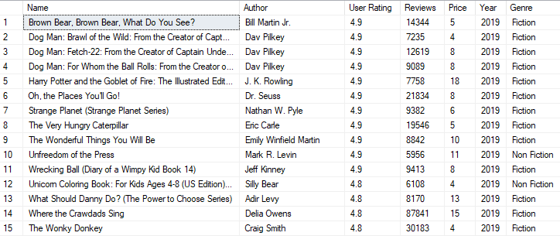
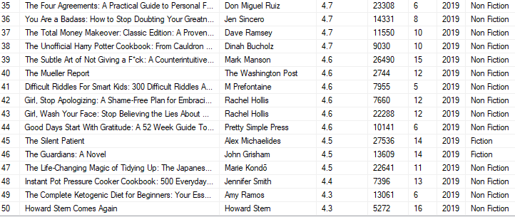
Summaries: Rating
This table shows the data based on rating greater than 4 in 2019
The table on the left is the Top 15 based on User Rating and the table on the right is the Bottom 15
From what we can see in 2019 based on user rating, people tend to give a higher rating to fiction writing compared to non-fiction

Slide 10
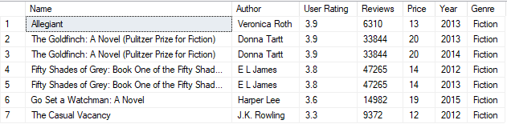
Own Summaries: Rating
This data shows user rating below 4
The table shows all the books that have a user rating of below 4
From what we can see, the only genre with a user rating less than 4 is fiction. Furthermore, 2 of the books are the same but are within the top 50 for 2 different years.

Slide 11
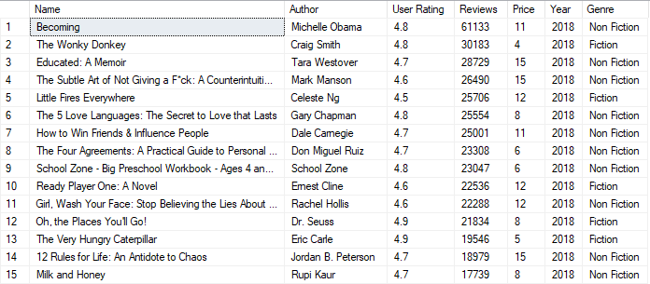
Summaries: Reviews
This table shows the data based on Reviews over 10,000 in 2018.
This shows the top 15 rows with the greatest number of reviews. Overall, there is 26 books that have over 10,000 reviews
From what we can see, non-fiction books tend to have more reviews in 2018 since there is an equal number of books with the fiction and non-fiction genre category that is greater than 10,000 reviews.

Slide 12
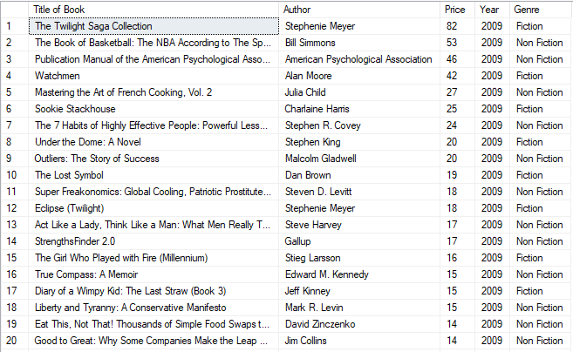
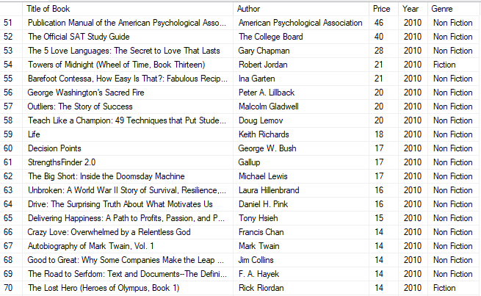
Own Summaries: Price
These tables show the most expensive books for each year.
The two tables show the title/name of the book, author, price, year it was within the top 50 and the genre. The two table specifically displays for the years 2009 and 2010.
Based on the first 2 years, the most expensive type of books are generally non-fiction books followed by a collection of books (generally fiction and with their sequential titles)

Slide 13
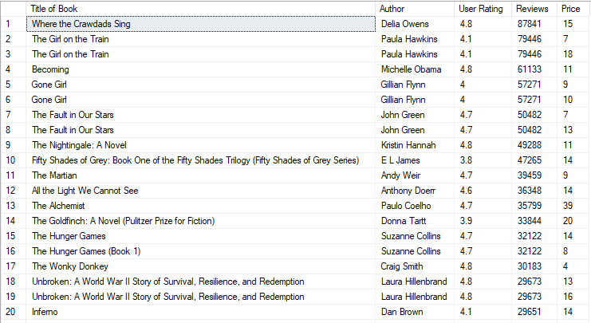
Own Summaries: User Rating & Reviews
The table displays the reviews in descending alongside user rating and price
The table is independent of the year and displays different books with unique rows
As mentioned previously, there are books that are the same with different pricing likely due to difference in the physical product like paperback or hardback.
Number of reviews seems to be independent of both user rating and price based on the table with rather minor correlation.

Slide 14
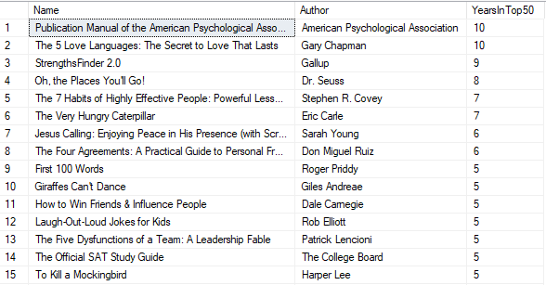
Own Summaries
This data demonstrates the books that are in the top 50 more than once
As we can see from the table quite a few books has made it into the top 50 best seller more than once. From number 1 and 2 we can see that these books has made into the top 50 best seller every year (2009-2019)

Slide 15
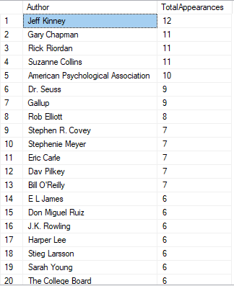
Own Summaries
This data shows the total number of times an author has come up in the overall dataset
This table could indicate how popular an author is based on the frequency his/her works has made it into the top 50.
It combines the books that make into the top 50 multiple years and the different works of the same author that makes it into the top 50.
From numbers 1 we can infer that each author has at least more than book placed within the top 50 within a single year at some point between 2009-2019

Slide 16
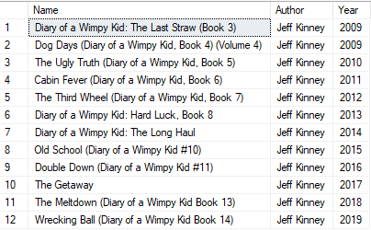
Own Summaries
Table of the author that appears the most
In this analysis, we further pulled ‘ Jeff Kinney’ the author that appears the most within the top 50.
We can see in 2009 he has two books that has made into the top 50.
In the subsequent years his books has consistently placed within the top 50 which suggest his book’s series popularity.

